Slide 1
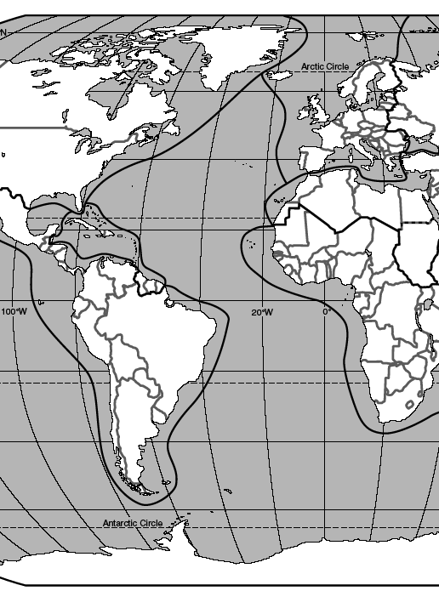

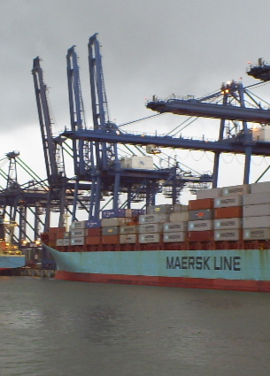
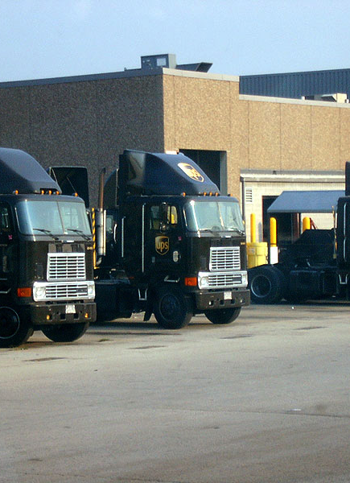
“Major Economies of Latin America”
Doing Business in Latin America (Ag and otherwise)
Matt Jordan, Masters in International Business, Thunderbird
International Ag Management – San Antonio, 2024
FELISA PRECIADO, PH.D.

Slide 2
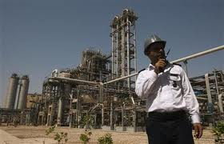
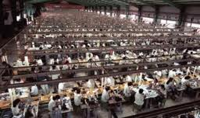
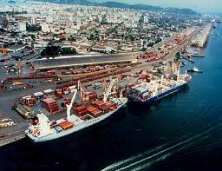
Topics
Context - PESTLE
Major Economies and Map
Political / Economic Systems
Hofstede Analysis
Important Statistics
Inequality
Exports
Imports
Multinationals
Trading Partners
Challenges and Opportunities

Slide 3
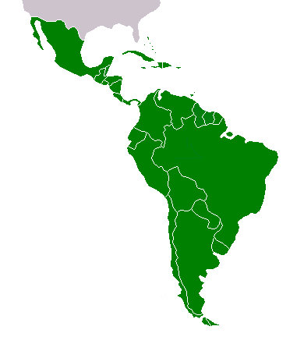
Major Economies of LA
Brazil / Argentina
Peru / Chile
Colombia / Panama
Venezuela
Mexico

Slide 4
Latin American Map

Slide 5
Political / Economic Systems
Brazil – Democratic Republic / Socio-Capitalism
Argentina – Populist Democracy / Socio-Capitalism
Peru – Elite Democracy / Socio-Capitalism
Chile – Democracy / Socio-Capitalism
Industry, Public Sector, Education, Healthcare, Retirement, and Food/Living

Slide 6
Political / Economic Systems
Colombia – Democracy / Socio-Capitalism
Panama – Elite Democracy / Capitalism
Venezuela – Authoritarianism / Communist Oligarchy
Mexico – Democracy / Capitalism
Industry, Public Sector, Education, Healthcare, Retirement, and Food/Living

Slide 7

Hofstede Analysis – United States
Power Distance 40 Hierarchy vs. Equality
Individualism 91 I vs. We
Masculinity 62 Work to Live vs. Live to Work
Uncertainty Avoidance 46 Risk Tolerance - Now
Pragmatism 26 Risk Tolerance - Future
Indulgence 68 Enjoy Life vs. Restraint

Slide 8


Hofstede Analysis – BR / ARG
Power Distance 69
Individualism 38
Masculinity 49
Uncertainty Avoidance 76
Pragmatism 44
Indulgence 59
Power Distance 49
Individualism 46
Masculinity 56
Uncertainty Avoidance 86
Pragmatism 20
Indulgence 62

Slide 9


Hofstede Analysis – PR / CH
Power Distance 64
Individualism 16
Masculinity 42
Uncertainty Avoidance 87
Pragmatism 25
Indulgence 46
Power Distance 63
Individualism 23
Masculinity 28
Uncertainty Avoidance 86
Pragmatism 31
Indulgence 68

Slide 10


Hofstede Analysis – CO / PA
Power Distance 95
Individualism 11
Masculinity 44
Uncertainty Avoidance 86
Pragmatism
Indulgence
Power Distance 67
Individualism 13
Masculinity 64
Uncertainty Avoidance 80
Pragmatism 13
Indulgence 83

Slide 11


Hofstede Analysis – VZ / MX
Power Distance 81
Individualism 12
Masculinity 73
Uncertainty Avoidance 76
Pragmatism 16
Indulgence 100
Power Distance 81
Individualism 30
Masculinity 69
Uncertainty Avoidance 82
Pragmatism 24
Indulgence 97

Slide 12

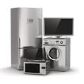


Important Statistics - Brazil
Brazil - one of the BRICS, large country – land and population
GDP – 2.2+ Trillion USD vs. 24 Trillion in US / 17 Trillion in China
GDP – has fallen – low oil / commodity prices
Inflation – 6.5% vs. 3-4% in US
BOVESPA - 1.167 T USD – Sao Paulo stock exchange - 4th largest in the world, own Chicago Board of Trade

Slide 13
Important Statistics - Brazil
GDP per capita - $10,000 USD vs. $65,000 in US
Consumption – 62% vs. 78% US vs. 35% China
20% at $100 per month / 40% at $750 - $1250 (middle class)
Racial mix – 1% indigenous/7.5% Black/47% White/43% Mixed
Large immigrant population – Portuguese, Italians, Spanish, Japanese, Lebanese, African

Slide 14
Important Statistics - Argentina
Large country – land wise but only 44 million people
GDP - 650 – 450 B / GDP per capita – 14 – 10K – Now – 10 – 8k
Unemployment – 7%
Inflation – 200+ %
FX – 12 – 18 – Pesos to USD – Now = 842
Base interest rate – 23% - Now = 133%
Poverty – 25%, Middle Class – 32%
Large European immigrant population – 86%

Slide 15
Important Statistics - Peru
Large country in terms of land / 32 million people
GDP – 210 B / GDP per capita – 6.5K / Good growth
Unemployment – 6%
Stable currency - Sol
Inflation – 270 + % for 40 years, then to 3 %
Base interest rate – 6%
Poverty – 21%, Middle Class – 35 - 57%
Indigenous, Mestizo, Spanish, Japanese, some African

Slide 16
Important Statistics - Chile
Longest country in world but only 18 million people
GDP – 277 B / GDP per capita – 15K / Good growth
Unemployment – 7%
Stable currency
Inflation – Stable at 3 – 4%
Base interest rate – 7+ %
Poverty – 14 - 11%, Middle Class – 84 %
Indigenous, Mestizo, Spanish, German, Italian

Slide 17
Important Statistics - Colombia
Large country / Large population – 50 million / Stability now
GDP – 309 B / GDP per capita – 6.35K / Good growth
Unemployment – 10%
Stable currency
Inflation – Stable at 5 + %
Base interest rate – 12 - 13%
Poverty – 30%, Middle Class – 51 %
Indigenous, Mestizo, Spanish, African

Slide 18
Important Statistics - Panama
Tiny country / Small population – 4 million
GDP – 154 B / GDP per capita – 20K / Strong growth – 7+%
Unemployment – 8%
USD is the currency
Inflation – Stable at 3 + %
Base interest rate – 1 - 2 %
Poverty – 37%, Middle Class – 32%
Mestizo, Indigenous, Spanish, Caribbean, African, International

Slide 19
Important Statistics - Venezuela
Large country / 31 million people / Violence and Emigration
GDP – 482 - 92B / GDP per capita – Was 15.5K / Meltdown
Unemployment – Was 7%, now over 25%
Crumbling currency
Inflation – 9% per month
Base interest rate – Was 22%, now 57%
Poverty – 76 - 87%, Middle Class – Almost non existent
Indigenous, Mestizo, African

Slide 20
Important Statistics - Mexico
Large country / 130 million people / Violence along border
GDP – 1.15 T / GDP per capita – 9K / Steady growth
Unemployment – 3 – 4 %
Currency – stronger against US dollar
Inflation – Stable at 5 %
Base interest rate – 11.25 %
Poverty – 40%, Middle Class – 40%
Indigenous, Mestizo, Spanish, American, German, African

Slide 21
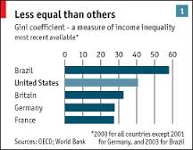
Inequality in Latin America

Slide 22
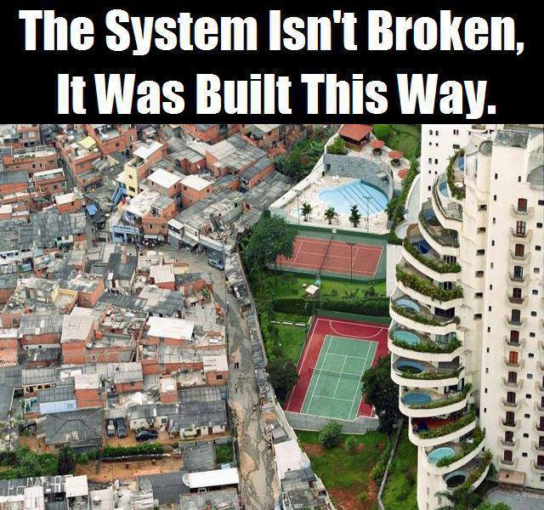
Inequality in Latin America

Slide 23
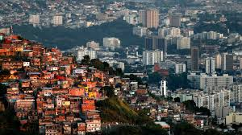
Inequality in Latin America
US – 41
European countries – 25 – 30
Brazil – 51
Argentina – 42
Peru – 44
Chile – 47
Colombia – 51
Panama - 51
Venezuela – 46
Mexico – 48

Slide 24
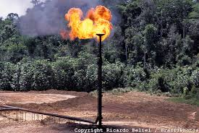
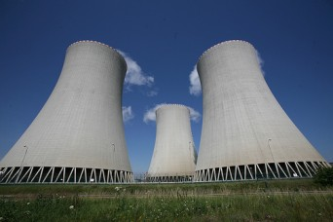
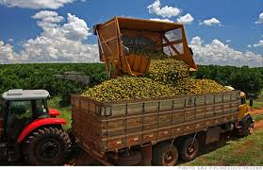
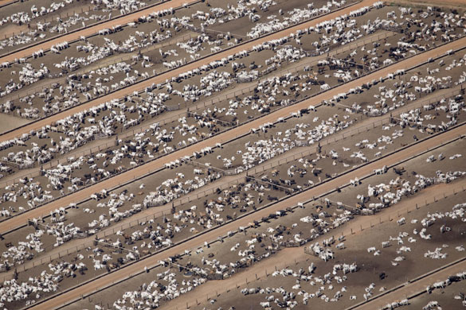
Brazilian Exports – Raw Materials
Oil and Natural Gas – Amazon, Espirito Santos, Rio, Bahia
Energy – Hydroelectric (80+%), ethanol, nuclear, bio fuels (bagasse)
Petrochemicals – SP, Rio, Northeast, 1960’s to present, plastics, naphtha, and other chemicals
Agriculture – corn, soybean, orange juice, livestock (chicken and beef), forestry

Slide 25


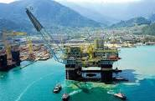
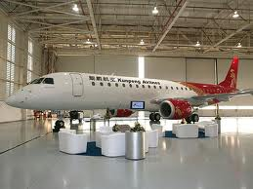
Brazilian Exports – Value Added
Textiles and Shoes – South of Brazil
Heavy Manufacturing – Cars, airplanes, submarines, military equipment, ship building, appliances – Sao Paulo and throughout Brazil
Technology and Service Sector – Sao Paulo, Pernambuco, Curitiba, Rio, South of Brazil – IT, security, banking, retail, government, telecom, tourism

Slide 26
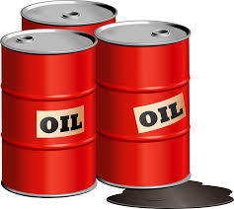

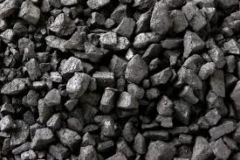
Imports - Brazil
Crude – 6.2% - Venezuela / Automobiles – 5.3% - Global
Gas – 3.4% - Cars and transportation - United States
Auto Parts – 2.8% - Global / Drugs/Medicine – 2.6% - US, Europe
Naphtha – 2.1% - Petrochemical industry, plastics - United States
Electronic Components – 1.9% - Cell phones, telecom, IT - China, Asia
Coal – 1.9% - Steelmaking - US, Australia, Columbia
Reception and Transmission Parts – 1.6% - Telecom - US, Europe, Asia
Potassium Chloride – 1.4% - Fertilizer - China, Russia, US, North Africa
Domestic Production and High Import Tariffs, Protectionism

Slide 27
Exports – Argentina
One of the world’s largest agriculture producers - Beef, corn, soybean, wheat plus Citrus fruit, grapes, honey, sorghum, squash, sunflower, yerba mate, fish and fish meal, wine
Cars and Auto Parts
Crude, Natural Gas, Petrochemicals
Wood pulp, Leather, and Wool
Iron Ore and Steel, other minerals
Pharmaceuticals

Slide 28
Imports - Argentina
Cars and Auto Parts
Electronics, telephones
Minerals and fertilizers
Finished plastics
Aircraft, ships
Beverages

Slide 29
Exports/Imports – Peru
Exports – Copper, Gold, Silver, Textiles, Wool, Chemicals, Fish Feed and Animal Meal, Fruits and Vegetables, Grains
Imports – Refined Oil, Crude Oil, Cars, Broadcasting Equipment, Computers
Free Trade Agreements with the US and Andean Region
Big promotional efforts on exports and increased trade with the US and now Asia – absence of TTP

Slide 30
Exports/Imports - Chile
Exports – Copper, Fruits and Vegetables, Fish and Fish Products, Paper and Pulp, Lumber, Wine, Chemicals
Imports – Fuel – Crude and Refined, Aircraft, Petroleum Products, Computers, Telecommunications Equipment, Industrial Equipment
Strong Free Trade Agreements with the US and countries in Asia
Big investment in IT and new industries – banking, applications, services, trade logistics

Slide 31
Exports/Imports – Colombia
Exports – Oil, Coal, Flowers, Coffee, Nickel, Gold, Bananas, Tropical Fruits, Textiles, Clothing, Car Parts, Light Manufacturing
Imports – Machinery, Electronics, Vehicles, Organic Chemicals, Plastics, Medical Equipment, Steel and Building Products
Drug Trade – 20% down to 1 – 2%
Big investments in Education, Innovation, and IT – Medellin
Trade Agreements with US

Slide 32
Exports/Imports - Panama
Exports – Auto / Aircraft spare parts, Cement, Drinks, Adhesives, Textiles, Sugar, Shrimp, Coffee, Bananas, Tourism
Imports – Chemicals, Pharmaceuticals, Electronics, Clothing, Footwear, Fuel
The Panama Canal brings in 50 Billion USD in revenue per year - Banking and logistics are major supporting industries to the Canal and economy of Panama

Slide 33
Exports/Imports – Venezuela
Oil Oil Oil – over 90% of exports are crude and refined oil, but oil is dirty and more expensive to refine – Valero and Citgo
More exports – Gold, Iron Ore, Rice, Fish, Tropical Fruit, Coffee, Beef, Pork
Imports – 2/3 of food imported – agriculture and livestock, chemical products, manufactured goods, machinery, transportation equipment
Domestically produced products but prices are low – Communism
Economy and political system in Free Fall

Slide 34
Exports - Mexico
Crude oil, Petrochemicals, Plastics, Minerals, Gems
Vehicles and cars, Electrical machinery and heavy machinery
Furniture, bedding, lighting, prefab construction materials
Medical Equipment
Vegetables – tomatoes, avocados, other fresh fruits & vegetables
Alcoholic Beverages, Rubber
Snack Foods
Processed Fruits and Vegetables

Slide 35
Imports - Mexico
Machinery – electronics and industrial
Computers
Vehicles
Oil and Gas
Medical Equipment
Plastics
½ Trillion in Trade with US and Canada – USMCA
Drug trade = 60 billion plus – from Colombia to Mexico

Slide 36





















Multinationals

Slide 37
Trading Partners
Brazil – China, US, Argentina, Chile, Peru, Mexico, EU
Argentina – US, Germany, Brazil, Chile, Mexico, EU
Peru – US, China, Brazil, Chile, EU
Chile – China, US, Japan, Brazil, South Korea, Holland, Italy
Colombia – US, Mexico, Venezuela, Brazil, China, Ecuador
Peru – US, Canada, Costa Rica, Holland, Hong Kong
Venezuela – US, China, Brazil, Colombia, Mexico, Argentina
Mexico – US, Canada, Germany, China, Brazil, Colombia
Do you see any patterns?

Slide 38
Structural Challenges in Latin America
Reliance on Commodities - O&G, Mining, Agriculture
Protectionism vs. Free Trade
Bureaucracy
Corruption at All Levels
Confidence and Foreign Direct Investment
Fiscal vs. Monetary Policies
Education, Training, Better Management and Logistics
Infrastructure
Private Sector Job Creation vs. Public Sector Job Dependency
Consistently low wages
Inequality and the Middle Class
Violence, Gangs, Narco-Trafficking
Consolidated Wealth, Political Power, and Education
Impact of Slavery – Past and Present

Slide 39
Activity
Breakout Rooms
Ag Activity – Answer Q’s
Brainstorm challenges and potential solutions in previous slide – pick 3 or 4
Present findings and ideas to class

Slide 40
Questions
Questions?
Let’s go to Challenges in Latin America slide and My Conclusions
?????

Slide 41
My Conclusions
Start with Education –
Builds confidence and reduces inequality
Reduces crime/drugs/violence/corruption
Improves productivity
Helps create new jobs and companies

Slide 42
My Conclusions
Diversify economies by reducing dependence on raw materials, bringing in FDI, and engaging in more trade
Privatize state-owned dinosaurs
Reduce bureaucracy and fight corruption – politics and local communities
Reduce public sector and fiscal budgets – slowly
Invest heavily in infrastructure, education, and labor force development via public and private sector, JV’s, and FDI
Get more political involvement - democracy

