Slide 1
Hofstede Analysis
US China Brazil
City U of Seattle - China Program
MBA 500 – Essentials of Business Management
Professor Matthew Jordan

Slide 2
Table of Contents
Introductions
6 Cultural Dimensions of Hofstede Analysis
Discussion
US
China
Brazil
Breakout Session - US / China / Brazil (Team dynamics)
Key Takeaways

Slide 3

Introductions
Professor Matthew Jordan
MBA in International Marketing at Thunderbird – 2001
International Business Professor, Grant Writer / Manager
Banking, Commercial Real Estate, Business English
COIL, GCP’s, AAOU and ICDE, China and Brazil
Students
Name, Major, Graduation date
Title and Work experience
Interests and Hobbies

Slide 4
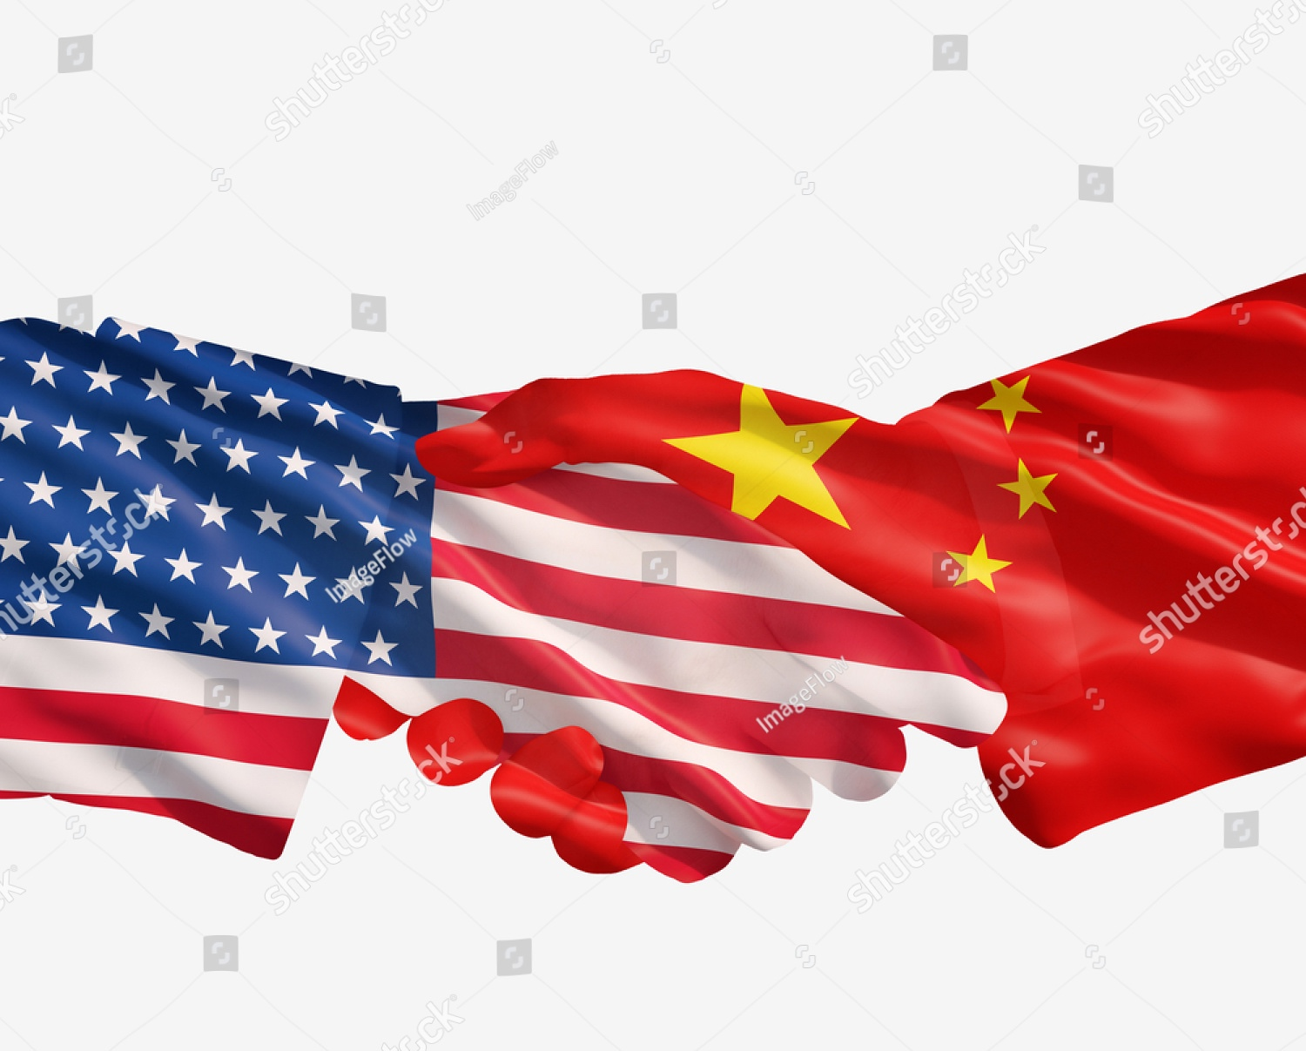


6 Cultural Dimensions
General Drivers behind Culture
Geert Hofstede – largest cross-cultural study in social science history
Power Distance
Individualism vs Collectivism
Masculinity vs Femininity
Uncertainty Avoidance
Long-Term vs Short-Term Orientation
Indulgence vs Restraint

Slide 5

Power Distance
High vs Low
Degree to which less powerful people accept and expect unequal distribution of power
Hierarchy
Centralized authority
Gap - leaders and subordinates, rich and poor, old and young
--------------------------------------------------------
Equality
De-centralized decision-making
Challenge authority

Slide 6

Individualism vs Collectivism
Needs and goals of individual vs group
Individualism
Independence
Rights and opinions
Personal achievement
Collectivism
Tight-knit group
Family, community, company
Loyalty, harmony, and group goals first

Slide 7

Masculinity vs Femininity
Masculinity
Competitive, ambition, achievement
Live to work, clear gender roles
Femininity
Relationships, cooperation
Caring for others, modesty
Work-life balance, quality of life
Gender roles are fluid

Slide 8

Uncertainty Avoidance
High vs Low
High
Discomfort with ambiguity
Prefer rules and planning
Minimize unknown with clear structure
Low
Comfort with risk taking
Improvisation
Flexibility with rules

Slide 9

Long-Term vs Short-Term
Orientation
Future reward vs nearer term reward
Long
Perseverance, thrift, adapting to change
Long-term results
Short
Value tradition, current social structure
Hierarchy, obligations
Protecting “face” or avoiding failure

Slide 10

Indulgence vs Restraint
Control of desires and impulses vs freedom to have fun
Indulgence
Gratifying basic and natural drives
Enjoying life and having fun
Restraint
Suppression of gratification
Regulation of needs via strict norms

Slide 11
United States

Slide 12
United States Analysis
How do Americans typically view their relationship with the boss ?
How does marketing promote individual achievement over group harmony in the US ?
Is there a shift toward more feminine values, such as cooperation and caring, occurring in the US workplace ?
Why do you think start ups and entrepreneurs thrive in the US ?
How do Americans typically approach planning vs short term results in the workplace ?
Give an example of indulgence in American media ?

Slide 13
China

Slide 14
China Analysis
How does Confucianism impact the relationship between managers and their subordinates in China ?
Why is the team more important than the individual in the workplace in China ?
Are status and success important in Chinese society and the workplace ?
Is the status quo or innovation more important in Chinese companies ?
How do Chinese typically approach long-term planning vs short term results in the workplace ?
Are Chinese consumers more indulgent or self-restrained in their spending behavior ?

Slide 15
Brazil

Slide 16
Brazil Analysis
Are Brazilians comfortable questioning or challenging their managers ?
How important is teamwork compared to individual achievement in the Brazilian workplace ?
What does the work-life balance look like in Brazil ?
How does uncertainty avoidance influence innovation and entrepreneurship vs the norm and bureaucracy in Brazil ?
How do Brazilians generally approach planning vs short-term goals in the workplace ?
How does indulgence show up in Brazil’s daily routines, media, festivals, and overall lifestyle ?

Slide 17
Brazil / China / US

Slide 18
Breakout Session – Team Dynamics
Cultural Dimension | United States | China | Brazil
Power Distance | Low | High | High
Individualism / Collectivism | Very High | Moderate | Moderate
Masculinity / Femininity | High | High | Moderate
Uncertainty Avoidance | Low to Moderate | Low to Moderate | Very High
Long-Term / Short-Term Orientation | Moderate | Very Long-Term | Short-Term
Indulgence / Restraint | Very High | Low | High
What challenges might arise on this global team due to different views of hierarchy?
How might individualism vs collectivism impact this team’s dynamics?
How would a leader balance achievement with the overall well-being of the team?
How would different comfort levels toward uncertainty impact the problem solving and decision making process of the team?
If quarterly growth and profits were important KPI’s, how might this team reconcile short term gains with long term goals?
Give some examples of how comradery, trust, and relationships could be built in and out of work with this team?

Slide 19

Key Takeaways
What do you think of this tool?
What can it be used for?
General Areas of Business
Management – PD, leadership and org structure
Operations – UA, I/C, autonomy and training
Marketing – I/C, M/F, who wins and who loses ?
HR – I/C, M/F, rewarding performance
Strategy – Long term vs short term, UA, I/R
CSR – Indulgence vs. restraint, L-T vs S-T, I/C
Finance – UA, L-T vs. S-T
R & D – L-T vs. S-T, UA

Slide 20
Key Takeaways
More Specific Business Uses
Business trips and trade shows (PD, I/R, I/C)
Short-term projects – virtual, in-person, hybrid (S-T, PD, UA, I/C)
Long-term overseas assignments for expats (L-T, PD, I/C, M/F)
Male / Female work relationships (PD, M/F, I/R)
Interviews (PD, M/F, UA)
Communication between managers and subordinates (PD, M/F)
Conflict resolution (PD, I/C, M/F)
Motivating employees and performance goals and reviews (PD, I/C, M/F)
Compensation, benefits packages, and even job descriptions (M/F, I/C)
Market segmentation, customer profiles, marketing design and mix (All)
Sales and negotiations (PD, I/R, M/F, UA)
Customer service training and delivery (PD, M/F, UA)
Risk analysis and management (UA, L-T/S-T, I/R)
Mergers and acquisitions, joint ventures, international expansion (PD, UA, L-T/S-T)

Slide 21
Questions ???

